Slide 1
Using the New
Assessment of Lagging Skills
&
Unsolved Problems
(ALSUP 2020)
Michelle Rosenberg
michelle.r@cogeco.ca

Slide 2
Welcome
Introductions
Overview

Slide 3
How Many of You….
Have heard of an ALSUP?
Have used the old ALSUP?
Have used the new ALSUP?

Slide 4
Things I Find Hard About Using The ALSUP Are…

Slide 5
Old vs New- What’s the Same?
Single sided, single sheet of paper
Discussion Guide
Answers “why” and “when” behaviour is concerning…not “what”
Enables us to be explicit in our expectations
Moves us away from motivational explanations to ones that that focus on skills
Helps caregivers/educators appreciate why interventions focussed primarily on motivation (R & P) haven’t worked
Enables us to be proactive not reactive…“what do we do when?” not “what do we do before?”
Notes:
Say the same thing - The Game GalSay the same thing - The Game Gal thegamegal.com

Slide 6
We Still Use the Alsup 2020…
As the standard pre-/post-referral, triage and assessment instrument
With the top 10, 20, 30+ kids requiring the highest levels of support and greatest use of school resources…those most involved in ongoing discipline processes

Slide 7
ALSUP 2020- What’s Different?
Old ALSUP
New ALSUP
23 LS
LS on left; UPs on right
Theories-UPs tied to specific LS
60-90+ minutes
Generate own wording
18 LS
LS on top; UPs below
No theories- all skills contribute
30-45 minutes
Prompts provided

Slide 8
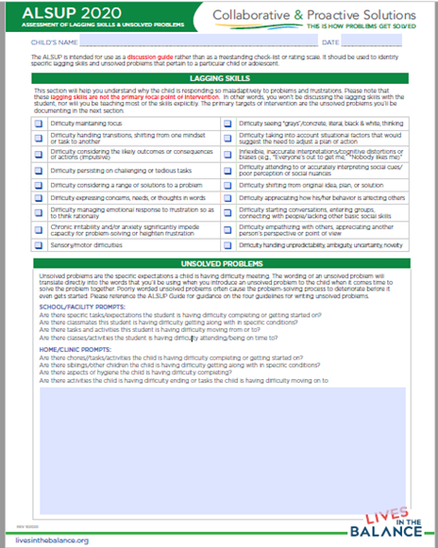
Top Half- Lagging Skills…the “Whys”
Representative set of skills frequently found lagging in kids with concerning behaviour
Skills important for responding to life’s challenges & frustrations adaptively
Not academic skills (literacy, numeracy)
Not “behaviour skills” (sitting in a chair)

Slide 9
Bottom Half- Unsolved Problems…the “Whens”
- Specific circumstances and contexts in which concerning behaviour is seen
- All expectations not being reliably met

Slide 10
How to Use the alsup 2020
All caregivers/educators most involved with the kid…worth the logistical hurdles
Lagging Skills (easy & fast)...3-5 seconds per skill
Start at the top- does this LS apply to this kid?”; no consensus needed; not 100%, “more often than not”
No need to establish which LS best explains an UP…multiple LS involved…going to find out from the kid during the Empathy Step
Unsolved Problems
Start with ALSUP prompts; consider ALSUP Guide 2020 examples
What else? Go through the day
Follow the four guidelines

Slide 11
Why is the Wording so Crucial?
Translates directly into the words we are going to use when the UP is introduced to the child at the start of a Plan B Empathy Step
Trying to optimize the likelihood the kid will talk to us
Poorly worded UPs often cause the entire problem-solving process to come to a dead stop even before it gets started… a “Failure to Launch”…
Notes:
Cartoon space rocket.png ...
commons.wikimedia.org

Slide 12
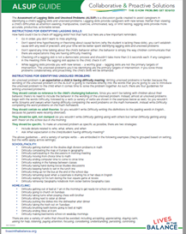
Same Four Guidelines- ALSUP Guide 2020
1. No reference to the child’s challenging behaviors. Start with replacement term “Difficulty”
2. No adult theories.
3. Split not clumped.
4. Specific contexts and expectations.
Two strategies:
a) “W” details (who, what, where, and when; not why)
b) Ask What expectation is the child/student having difficulty meeting?
Formula: Difficulty + verb (expectation) + context/circumstance specificity

Slide 13
Watch out for…
More than one unmet expectation per UP
“When”
Embedded LS language
“Tricky” verbs- accepting, listening, understanding, appreciating, paying attention
Embedded Plan A solutions
Vocabulary
Sentence length & structure
***Imagine saying these exact words to the kid
Notes:
Image 127897216.Caution Signs And People - Drawn Hand ...123rf.com

Slide 14
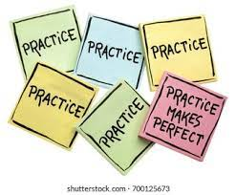
Let’s Practice!
Pick a kid, any kid
Start with the first prompt…break it down:
“Any tasks your kid/student is having difficulty getting started on?” Like what? Like when? Like where? With who?
Any tasks they’re having difficulty completing?” (‘w’s)
Keep going…

Slide 15
Let’s Check!
Any challenging or concerning behaviour language in your UPs?
Any adult theories? (“because”, “when”)
Any clumping going on? (getting along, schoolwork, chores)
All “w’s” answered?
Expectation clear? (what is he supposed to be doing? What are all the other kids doing that she’s not?)

Slide 16
Look for the “look fors”
More than one unmet expectation per UP
Other uses of “When”
Embedded LS language
“Tricky” verbs- accepting, listening, understanding, appreciating, paying attention
Embedded Plan A solutions
Vocabulary…kid friendly?
Sentence length & structure

Slide 17
Hmmm…what about this one?

Slide 18
LITB Training Opportunities
Half-day, 1 & 2 day
Skill Enhancement
School Implementation of CPS
15-week Proficiency
Provider Certification
For more information go to: https://livesinthebalance.org/workshops-and-trainings/

Slide 19
Final Thoughts and Questions

