Slide 1
Creating Change
Advocating for an End to Punitive and
exclusionary Disciplinary Policies
Children’s mental health advocacy conference 2023

Slide 2
Ben Jones, J.D. Director of Legal and Policy Initiatives benjones@livesinthebalance.org

Slide 3
Factors Influencing Change
1 - The Champion
2 – Data and Research
3 – Relationships
4 – Impact Stories
5 – News Coverage
X

Slide 4
Factor 1 - The Champion
The Champion Changemaker
Legislator
Advocate
Impacted Individual

Slide 5
Factor 2 – Data and Research
Robust, reliable data
Thorough, cited research
Professional experts
Digestible

Slide 6
Factor 3 – Relationships
Relationships with legislators
Relationships with fellow supporters
Relationships with journalists
Relationship with the issue

Slide 7
Factor 4 – Impact Stories
Your personal or professional story
Second-hand stories of those impacted
Historical stories from the news

Slide 8
Factor 5 – News Coverage
Interviews
Op-eds
Social media

Slide 9
X Factor – The Climate
All things being equal, The Climate is dispositive

Slide 10
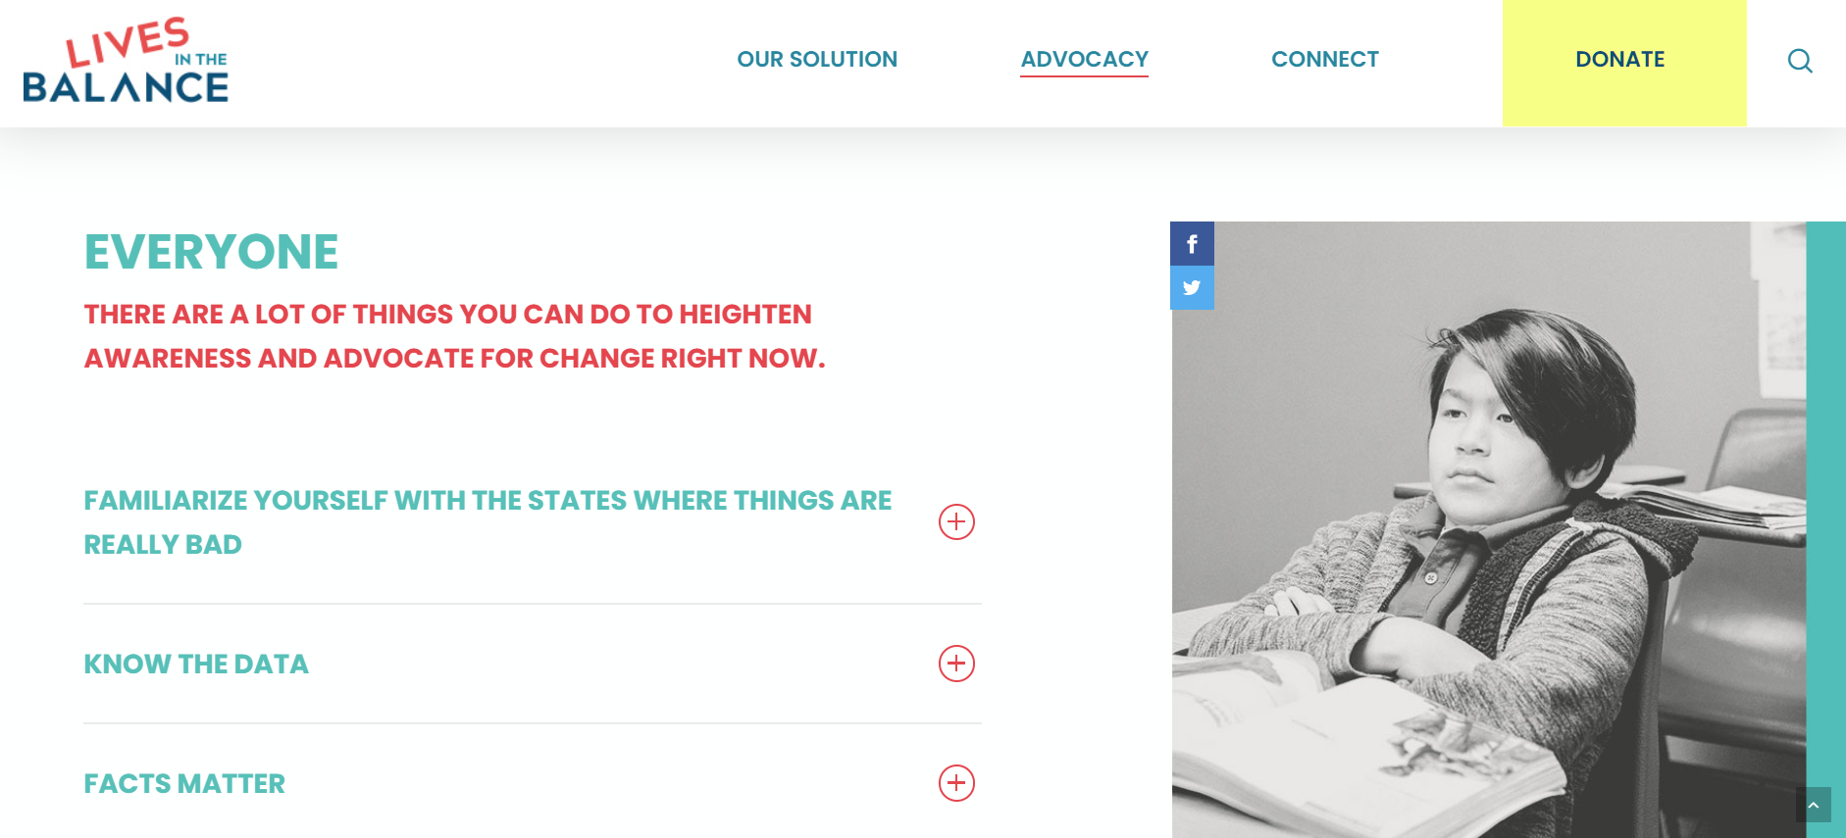
livesinthebalance.org/advocacy
Data and Research
Videos, maps, one-pagers
Take Action Links
Form Letters
More to come…

