Slide 1
Comorbid ADHD in Children with ODD or Specific Phobia: Implications for Evidence-Based Treatments
Thorhildur Halldorsdottir, M.S.
Kristin Austin, B.A.
Thomas Ollendick, Ph.D.

Slide 2
Overview
ADHD, ODD and Specific Phobia
Treatment Studies and Comorbidity
Present Studies:
Treatment of Oppositional Youth
Child Phobia Project
Implications and Future Directions
Notes:
During the presentation, I will very briefly review the diagnoses and previous treatment outcomes studies that examine the impact of comorbid disorders. Then I will present preliminary data from our two ongoing projects addressing the question of whether ADHD moderates treatment outcomes. Finally, I will discuss the implications of the findings and future directions.

Slide 3
ADHD, ODD, & Specific Phobia (APA, 2000)
Attention-deficit/Hyperactivity Disorder (ADHD) is characterized by patterns of distractibility, hyperactivity and impulsivity
Oppositional Defiant Disorder (ODD) is characterized by patterns of negativistic and hostile behaviors
Specific Phobia is characterized by an irrational fear of a specific object/situation
Notes:
There are three types of ADHD; ADHD-I, ADHD-H and ADHD-C. Children with ADHD-I have predominately problems associated with inattention and concentration difficulties. Children with ADHD-H have predominately issues with fidgeting, impulsivity and constantly being on the go. Lastly, children with ADHD-C have difficulties in both areas, i.e. with inattention and hyperactivity.

Slide 4
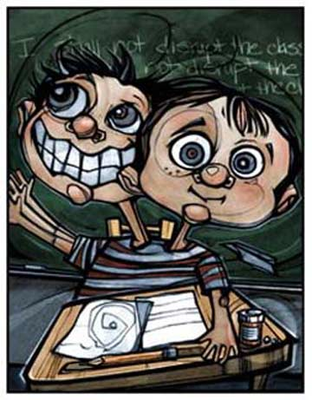
Comorbidity and Treatment Studies
ADHD is highly comorbid with internalizing disorders and other externalizing disorders (Angold, Costello, & Erkanli, 1999)
Limited research has been conducted examining whether ADHD moderates treatment outcomes (Ollendick et al., 2008)
Comorbid ADHD had no significant influence on treatment gains among youth with anxiety disorders or other externalizing disorders
Notes:
In their review, Angold and colleagues found that 0-23.7% of anxious youth have comorbid ADHD. They also found that 3.1-41% of children with conduct problems had comorbid ADHD. As you can see, ADHD is very common among children with internalizing and externalizing problems which is why we need to examine how it affects treatment outcomes. However, despite the high comorbidity rate few studies have examined whether ADHD impacts treatment outcomes. In the few studies that have looked at this, it appears that comorbid ADHD does not moderate treatment gains among youth with anxiety or conduct problems.

Slide 5
Child Study Center
Treatment of Oppositional Youth Project
Child Phobia Project
Notes:
As previously mentioned, we will be presenting preliminary results on both the current treatment projects at the CSC. Since Krystal and Maria have already given you an overview of the projects we are going to jump straight into our results. We will start with presenting our findings in the ODD project than the Phobia project.

Slide 6
Hypotheses for ODD Project
Hypothesis 1: ADHD does not moderate ODD treatment outcomes.
Hypothesis 2: Children with ADHD who received PMT will have a significant decrease in ADHD CSR after treatment, whereas, there will be no change in ADHD CSR for children who received CPS.
Notes:
As the title of the presentation implies, our overarching research question for both project was ‘Does ADHD moderate treatment outcomes?’. In accordance with previous research findings, we predicted that ADHD would not moderate treatment outcomes among youth with ODD.
Secondly, since PMT is an empirically supported treatment for ADHD, we predicted that children with ADHD who received PMT would have better treatment outcomes than children who received CPS. At present, no study has examined whether CPS reduces ADHD symptoms.

Slide 7
Measures
Anxiety Disorders Interview Schedule for DSM-IV, Parent and Child Version (ADIS; Silverman & Albano, 1996)
Disruptive Behavior Disorders Rating Scale (DBDRS; Pelham et al., 1992)
Children’s Global Assessment Scale (CGAS, Schaffer et al., 1983)
Notes:
The ADIS was used to assess for and assign diagnoses. As previously noted a clinical severity rating of 4 or above indicates a clinical diagnosis.
The maternal report on the DBDRS was used to assess ODD and ADHD symptoms.
Also, the CGAS, which clinicians use to indicate the child’s general level of functioning, was used to examine severity of symptomatology and functioning level between the treatment conditions to ensure that there were no group differences. A lower score signifies a lower level of general functioning.

Slide 8
Sample
 | Whole sample (n = 78) Mean(SD)N(%)
Age | 9.62(1.81)
Caucasian | 65(83.3%)
Male | 47(60.3%)
ADHD | 44(56.4%)
CGAS | 60.38(5.96)
ADHD medication | 20(25.6%)
Notes:
Ages ranged from 7 to 14 years old. As you can see, the majority are white. For just over half of the sample, ADHD was among the top three diagnoses.
In regard to the different subtypes, 15(19%) had ADHD-c as the primary diagnosis, 22(28%) had ADHD-c and 3(3.8%) had ADHD-I as the secondary diagnosis and 9(11.5%) had ADHD-c and 2(2.6%) had ADHD-I as a tertiery diagnosis.
A fourth of the sample was on medication for ADHD.

Slide 9
Sample cont.
 | PMT (n = 41) Mean(SD)N(%) | CPS (n = 37) Mean(SD)N(%) | Significance level
Age | 9.63(1.78) | 9.60(1.86) | ns
Caucasian | 31(75.6%) | 34(91.9%) | ns
Male | 23(56.1%) | 24(64.9%) | ns
ADHD | 25(61%) | 19(51.4%) | ns
CGAS | 59.15(6.61) | 61.76(4.89) | ns
ADHD medication | 11(26.8%) | 9(24.3%) | ns
Notes:
Chi square tests and t-tests were conducted to examine differences between treatment conditions. As can be seen in the table, no significant differences were observed on key demographic variables, such as age, gender, race. Also, the groups did not differ in global functioning or medication status.

Slide 10
Sample cont.
 | ODD-ADHD (n = 34) Mean(SD)N(%) | ODD+ADHD (n = 44) Mean(SD)N(%) | Significance level
Age | 9.69(1.83) | 9.56(1.81) | ns
Caucasian | 28(82.4%) | 37(84.1%) | ns
Male | 23(67.7%) | 24(54.5%) | ns
CGAS | 62.79(5.53) | 58.52(5.66) | s
ADHD medication | 1(2.9%) | 19(43.2%) | s
Notes:
Then we did the same to examine difference between children with and without ADHD in the sample. We also compared common demographic information between the ODD-ADHD and ODD+ADHD groups. As expected, children with ODD+ADHD had lower global functioning ratings ((in general an additional diagnosis lowers the CGAS rating) and they were more likely to be on ADHD medication than children in the ODD-ADHD group. All of the children on ADHD medication had a diagnosis of ADHD among the top three diagnoses, with the exception of one child.

Slide 11
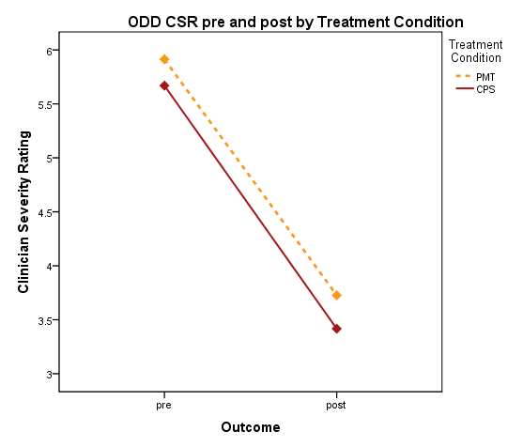
Findings
There was a significant change in ODD CSR from pre- to post- treatment (p<.05).
No difference in treatment outcome by condition (PMT vs. CPS, p=.892)
 | ODD CSR Pre | ODD CSR Post
PMT | 5.98 | 3.88
CPS | 5.68 | 3.43
Overall | 5.83 | 3.67
Notes:
We tested our hypothesis using a repeated measures ANOVAs. I do want to note that for all the following analyses we controlled for medication status. There was a significant difference in ODD CSR rating at pre and post treatment. However, there was no difference in treatment outcome by condition.

Slide 12
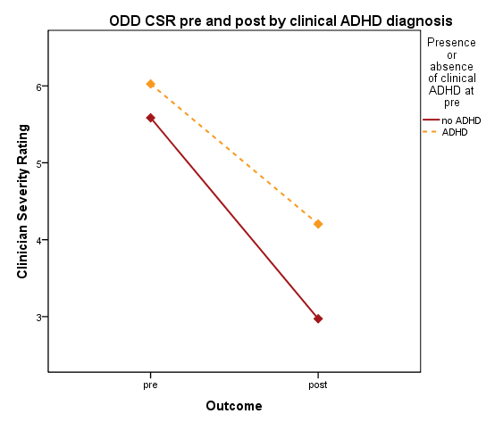
Findings cont.
ADHD did not predict treatment outcome when examining ODD CSR pre and post treatment; however, there was a trend (p=.137).
 | ODD CSR Pre | ODD CSR Post
No ADHD | 5.65 | 3.00
ADHD | 5.98 | 4.18
Overall | 5.83 | 3.67
Notes:
Then we looked at the impact ADHD had on treatment outcomes. On the figure, the children without ADHD are the red line and the children with ADHD are the yellow line. As you can see, the children without a clinical diagnosis of ADHD did slightly better in treatment than children with a clinical diagnosis of ADHD, although the finding was not significant.

Slide 13
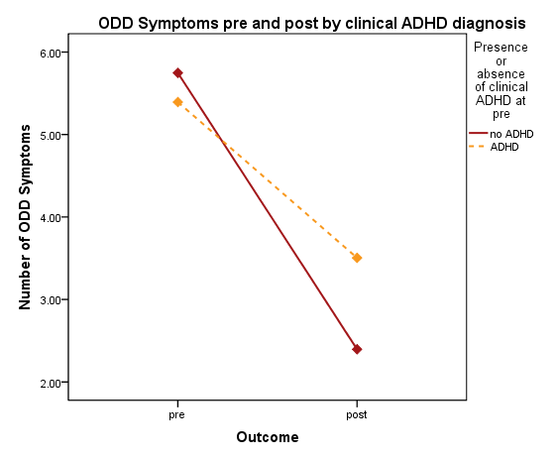
Findings cont.
ADHD did not predict treatment outcome based on maternal reported ODD symptoms on the DBDRS, although there was a trend (p=.05).
 | ODD Symptoms Pre | ODD Symptoms Post
No ADHD | 5.67 | 2.08
ADHD | 5.46 | 3.68
Overall | 5.56 | 2.94
Notes:
Similarly, looking at the maternal reported ODD symptoms a clinical ADHD diagnosis did not predict treatment outcome, although there was a trend. As you can see, children with ADHD fared slightly worse than children without ADHD.

Slide 14
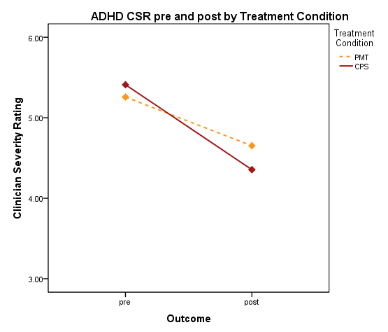
Findings cont.
In both treatment conditions, there was a significant change in ADHD CSR from pre- to post treatment (p<.05).
The interaction between outcome and treatment condition was nonsignificant (p=.310).
 | Mean ADHD CSR Pre | Mean ADHD CSR Post
PMT | 5.25 | 4.64
CPS | 5.42 | 4.37
Overall | 5.32 | 4.53
Notes:
Then we looked at ADHD CSR pre and post treatment, as you remember we predicted that children who received PMT would have a decrease in ADHD CSR rating at post treatment. On this figure, children who received PMT are the yellow line and the children who received CPS are the red one. There was a significant decrease in ADHD CSR rating from pre- to post treatment. To our surprise, there were no difference between the groups, p=.31. Specifically, children with ADHD who received CPS fared as well as children with ADHD who received PMT in regard to a decrease in ADHD symptoms. Note that on average both groups maintain a clinical diagnosis of ADHD.

Slide 15
Hypotheses for Phobia Project
Hypothesis: Attention problems do not moderate treatment outcomes of children with Specific Phobias.
Notes:
Now if we turn to the phobia project. In the phobia project, we had one hypotheses. Again, in accordance with previous studies, we predicted that ADHD would not moderate treatment outcomes of children with Specific Phobias.

Slide 16
Measures
Anxiety Disorders Interview Schedule for DSM-IV, Parent and Child Version (ADIS; Silverman & Albano., 1996)
Child Behavior Checklist (CBCL; Achenbach et al.,1991)
Attention Problems Subscale
Children’s Global Assessment Scale (CGAS, Schaffer et al., 1983)
Notes:
We used the ADIS to assess for a phobia and comorbid disorders.
Given that few participants had ADHD as one of the top three diagnosis, the maternal report of Attention Problems on the CBCL was used to examine moderation effects.
As with the ODD project, the CGAS was also used to examine group differences.

Slide 17
Sample
 | Whole sample (n = 96) Mean(SD)N(%)
Age | 8.95(1.72)
Caucasian | 84(87.5%)
Male | 47(49%)
ADHD | 13(13.5%)
High Attention Problems | 25(25.3%)
CGAS | 60.99(6.87)
ADHD medications | 8(8.3%)
Notes:
Ages ranged from 6-13 years old. In total, N=13 or 13.5% of participants in the phobia sample had a diagnosis of ADHD among the top three diagnoses. As previously noted, that is why we used the Attention Problems Scale on the CBCL to examine the hypothesis. Although the Attention Problems Scale is a continuous measure, we did a divided the sample into those with high and low attention problems because of the small number of participants with problems associated with attention.

Slide 18
Sample cont.
 | Standard (n=42) Mean(SD)N(%) | Augmented (n=54) Mean(SD)N(%) | Significance level
Age | 9.06(1.80) | 8.86(1.66) | ns
Caucasian | 35(83.3%) | 49(90.7%) | ns
Male | 22(52.4%) | 25(46.3%) | ns
ADHD | 7(16.7%) | 6(11.1%) | ns
High Attention Problems | 15(36%) | 10(19%) | ns
CGAS | 60.48(7.31) | 61.39(6.55) | ns
ADHD Medication | 4(9.5%) | 4(7.4%) | ns
Notes:
Now when comparing the two conditions, you can see that there were no significant differences on these variables. The p-value between high attention problems across conditions was .057

Slide 19
Sample cont.
 | Low Attention Problems (n=71) Mean(SD)N(%) | High Attention Problems (n=25) Mean(SD)N(%) | Significance level
Age | 8.77(1.65) | 9.46(1.84) | ns
Caucasian | 61(85.9%) | 23(92.0%) | ns
Male | 30(42.3%) | 17(68.0%) | s
ADHD | 3(4.2%) | 10(40.0%) | s
CGAS | 62.25(6.80) | 57.40(5.80) | s
ADHD Medication | 1(1.4%) | 7(28.0%) | s
Notes:
We also compared the low and high attention groups. There were several differences noted between the low and high attention problem groups. P=.086 for age difference between the high and low attention problems groups, which is not surprising since younger children tend to display more of these behaviors. Because of the gender differences, we controlled for gender in our main analyses.

Slide 20
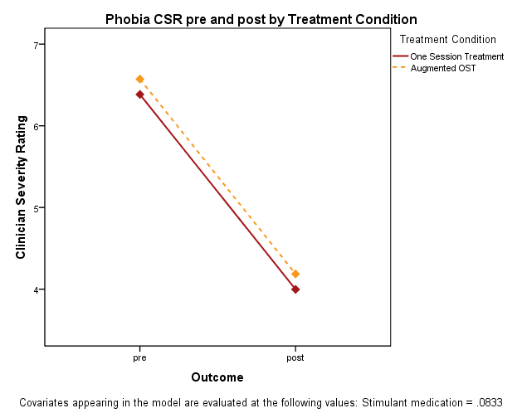
Findings
There was a significant difference in phobia CSR rating from pre- to post treatment (p<.05).
There was no difference in treatment outcome by treatment condition (OST vs. augmented, p=0.867)
 | Mean Phobia CSR Pre | Mean Phobia CSR Post
OST | 6.38 | 4.00
Augmented | 6.57 | 4.19
Overall | 6.49 | 4.10
Notes:
This slides shows you phobia CSR before and after receiving treatment. The children who were in the standard condition are the red line and the children who were in the augmented condition are the red line. At post, both groups showed a significant decrease in phobia CSR rating from pre.

Slide 21
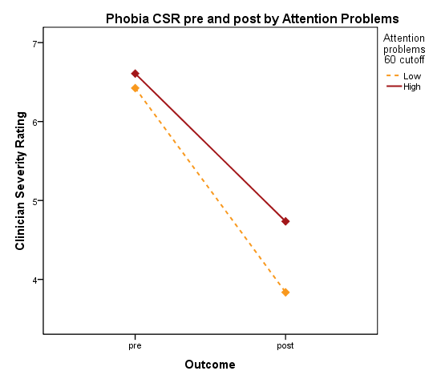
Findings cont.
Attention problems did not predict treatment outcome, although there was a trend (p=.144)
 | Mean Phobia CSR Pre | Mean Phobia CSR Post
Low attention | 6.45 | 3.87
High attention | 6.54 | 4.65
Overall | 6.49 | 4.10
Notes:
Now looking into how attention problems impacted treatment outcome. Here the children with low attention problems are the yellow line and the children with high attention problems are the red line. Children with high attention problems had slightly worse treatment outcomes than children with low attention problems, although the finding was not significant.

Slide 22
Conclusions
ODD Project:
ADHD did not moderate treatment outcomes.
However, based on consensus diagnosis and maternal report of ODD symptoms, there was a trend indicating that children with ODD+ADHD had slightly worse treatment outcomes than children with ODD-ADHD.
After receiving treatment for ODD, children with ADHD showed a significant decrease in ADHD CSR ratings, regardless of treatment condition. However, on average, children maintained a clinical diagnosis of ADHD.

Slide 23
Conclusions
Phobia Project:
ADHD did not moderate treatment outcomes.
Although, there was a trend. Children with high attention problems had slightly worse treatment outcomes than children with low attention problems.
Notes:
Phobia Project:
ADHD status did not significantly change as a result of treatment for a Specific Phobia, although there was a trend indicating a slight decrease in ADHD symptoms after receiving treatment for an anxiety disorder.
As previously noted, these are preliminary results and we are still running participants so it will be interesting to see whether the trend will become significant once we finish up both projects.

Slide 24
Implications and Future Directions
Children with an ADHD diagnosis may need prolonged therapy given that treating comorbid disorders does not address difficulties associated with the ADHD diagnosis
More research should be conducted examining treatment outcomes for children with multiple diagnoses
Notes:
As you saw previously, although there was a decrease in ADHD CSR rating, the children with ADHD still meet criteria for the diagnosis. Accordingly, children with an ADHD diagnosis may need prolonged therapy in order to better address the ADHD symptoms.
Given the high level of comorbidity and the trend of children with difficulties associated with ADHD in our studies, more research should be conducted examining how comorbid disorder impact treatment outcomes.

Slide 25
Acknowledgements
National Institute of Mental Health
CSC therapists and assessors

